Slide 1

Anchal Sharda

Slide 2
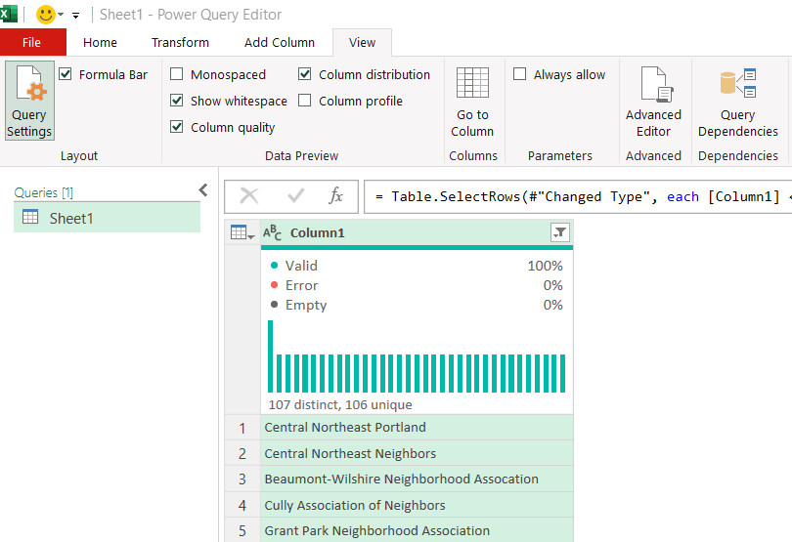
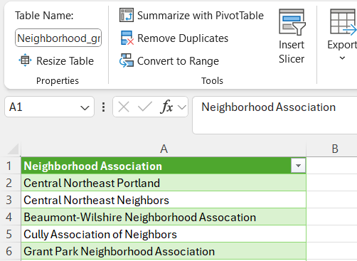
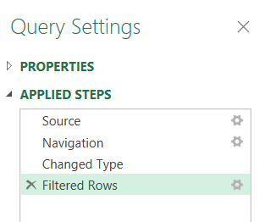
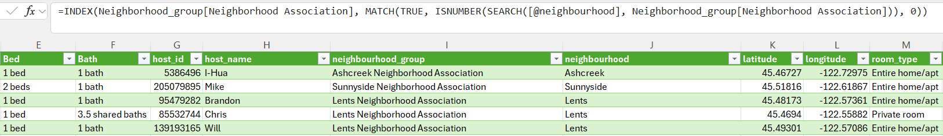
The Data Linking Process
Notes:
Jacelyn

Slide 3
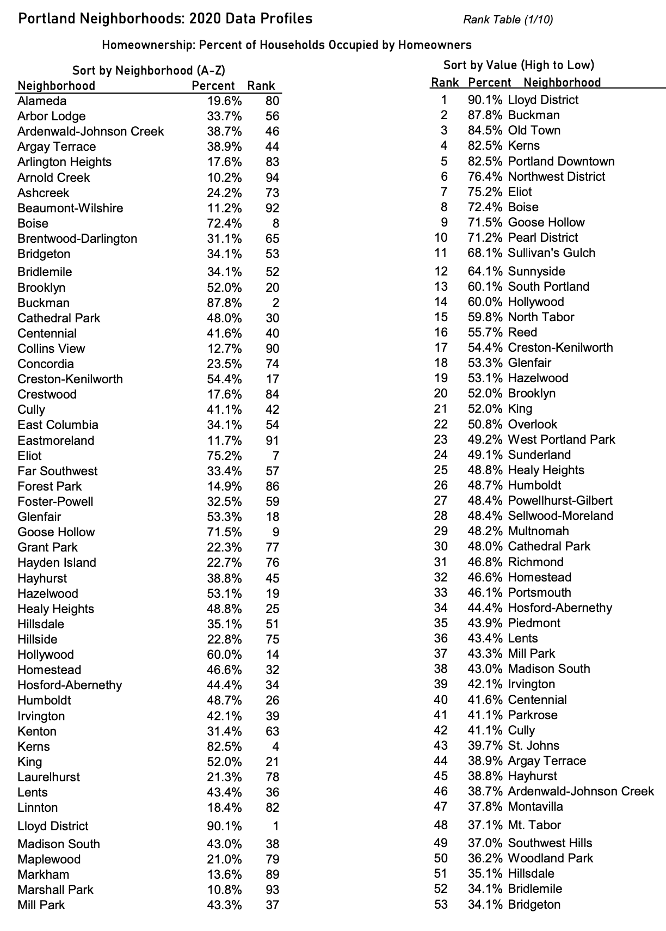
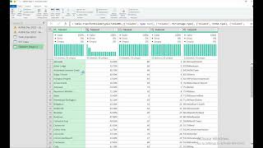
ETL Process
Extract From PDF
Source Link: https://youtu.be/FWdxdJ9Ib9Y
Notes:
Michael

Slide 4
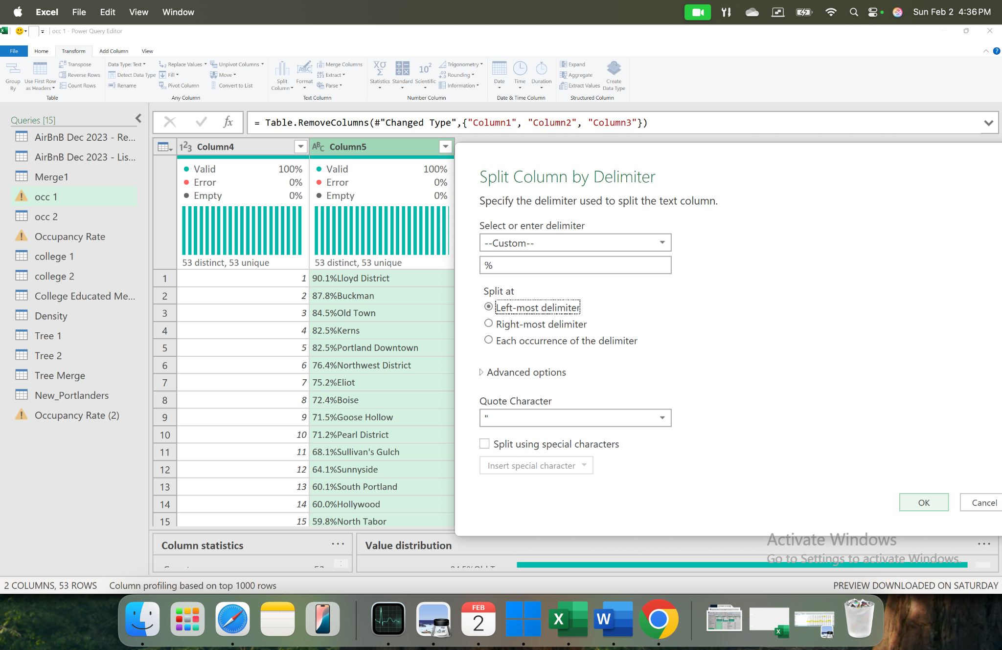
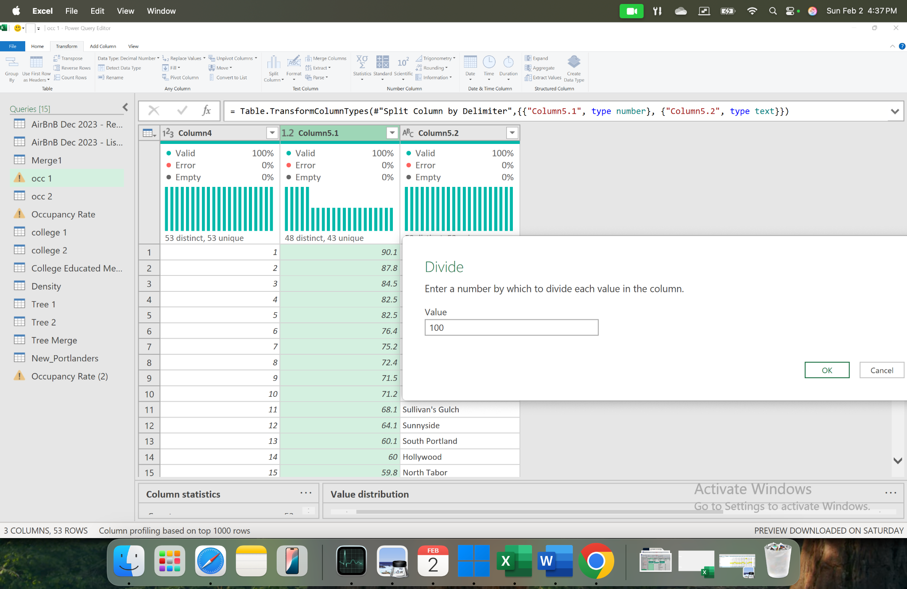
ETL Process
Untangling & Reformatting
Notes:
Miek

Slide 5
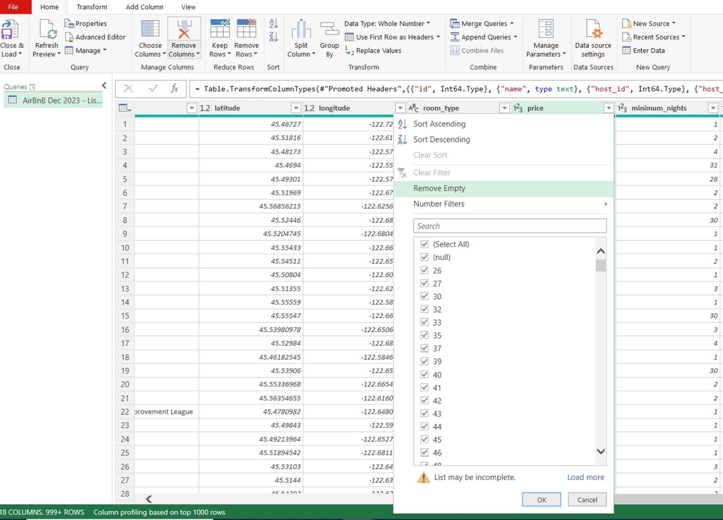
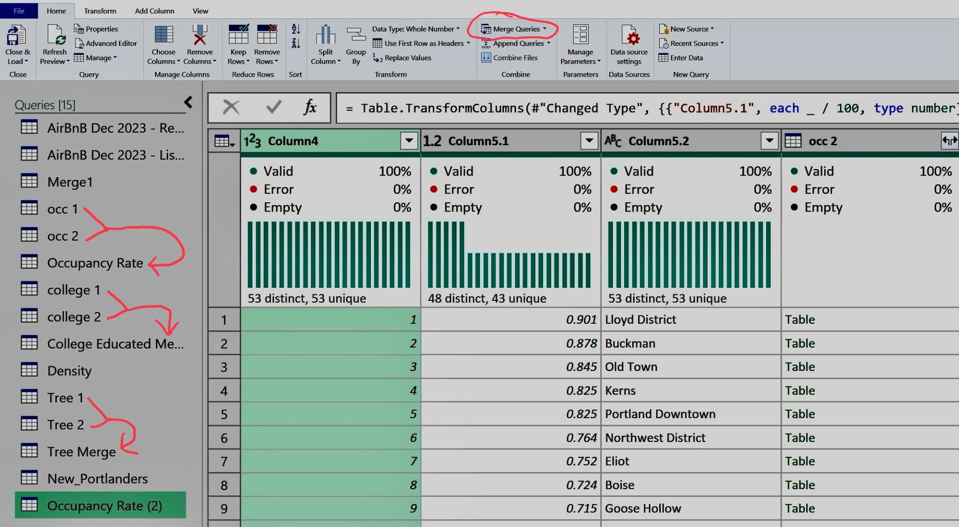
ETL Process
Removing Missing Data
Merging Files
Notes:
Mike

Slide 6
Initial Findings on Portland’s Current Short-Term Rental Market
Business Questions:
#1 What are some noticeable opportunities & risks the Data can teach us?
#2 Where are the most popular neighborhoods & what are the most popular types of housing?
#3 How does the percentage of college-educated households and the number of trees in the neighborhood influence rental demand?
#4 What are the top 5 neighborhoods in Portland for short-term and long-term rental investment?

Slide 7
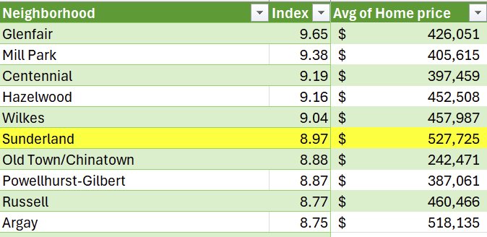
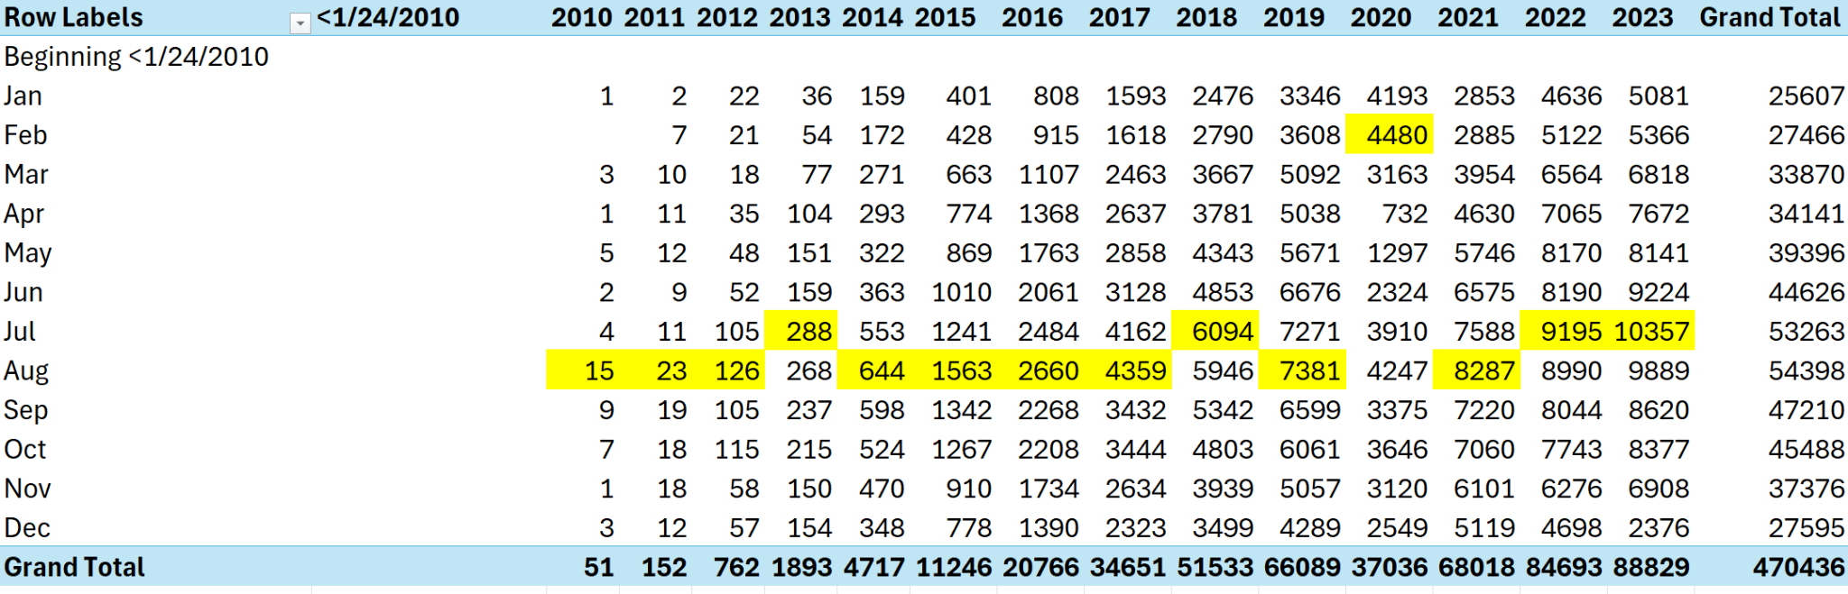
Opportunities & Risks within the Data…
SVT Index: Natural Disaster Vulnerabilities
Home value source: Zillow
Review Frequency & External Factors: COVID
Notes:
SVT Index- Sample of 10 neighborhoods by Home value.

Slide 8
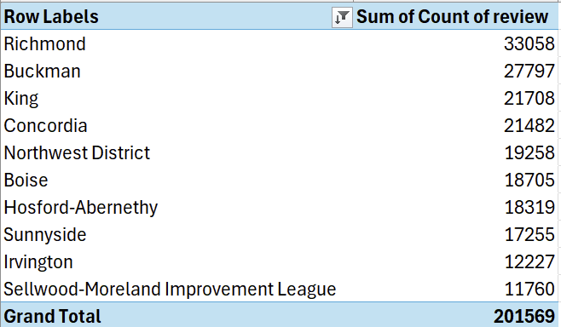
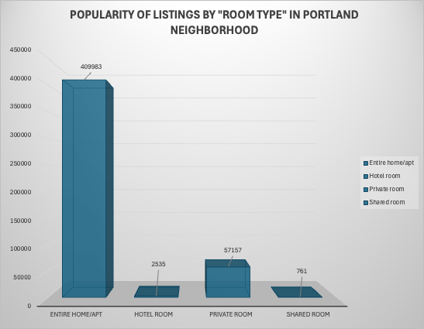
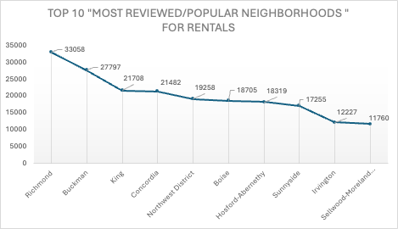
Targeting the Market
Overall
The data proves a clear categorical winner in market segmentation
Limited opportunities within hotel & shared rooms
Notes:
Richmond, Buckman and King lead in review counts making the top Airbnb investment locations.

Slide 9
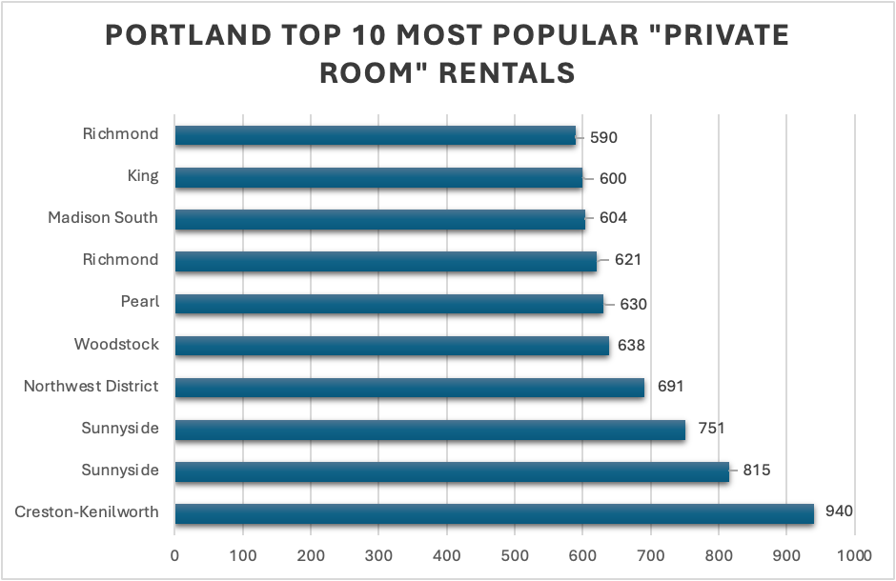
Assume the Revenue Target
Popular Private Room Rentals:
·
Opportunity to split housing dwellings into multiple sections for both short-term (high revenue per night) & long-term renters (guaranteed revenue).
Notes:
Hosford-Abernethy, Concordia and Humboldt are most reviewed neighborhoods with over 1000 reviews each, indicating higher rental activity.
Richmond appears twice in the top 10 reinforcing its strong demand for entire home rentals.
Boise also appears multiple times showing its key area for investment in short term rental properties.Hosford-Abernethy, Concordia and Humboldt are most reviewed neighborhoods with over 1000 reviews each, indicating higher rental activity.
Richmond appears twice in the top 10 reinforcing its strong demand for entire home rentals.
Boise also appears multiple times showing its key area for investment in short term rental properties. Entire Home /Apartments dominate the market while private rooms cater to budget conscious travelers.
Hosford-Abernethy, Concordia and Humboldt are most reviewed neighborhoods with over 1000 reviews each, indicating higher rental activity.
Richmond appears twice in the top 10 reinforcing its strong demand for entire home rentals.
Boise also appears multiple times showing its key area for investment in short term rental properties.
Kristen Kenilworth, Sunnyside and northwest district are the most reviewed neighborhood for private room rentals, highlighting areas with the demand for more affordable lodging options.
Richmond and king are also featured in top listings for private rooms further supporting the notion that these neighborhoods attract a wide range of Airbnb guests.

Slide 10
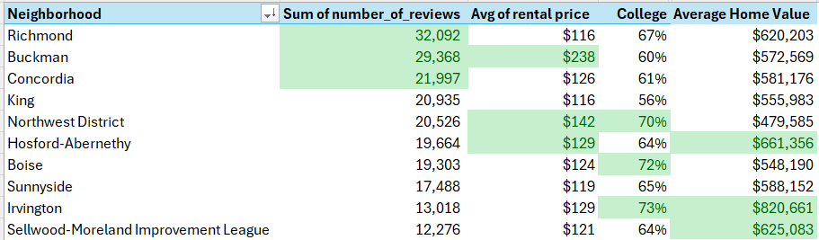
Question 3
How does the percentage of college-educated households impact rental demand, and can we assume that higher home values in these areas lead to higher rental rates?
Reference: Collected average home value from Zillow website.
Notes:
How does the homeownership ranking of a neighborhood affect its rental market potential?

Slide 11
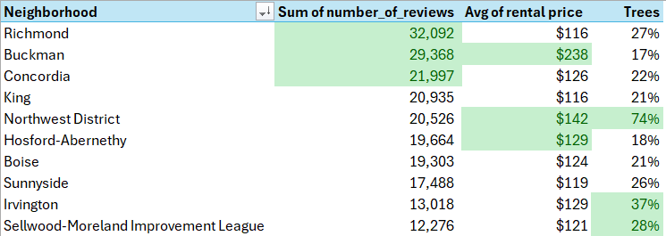
Question 3
Does the number of trees per neighborhood play a role in the desirability of a location for renters?

Slide 12
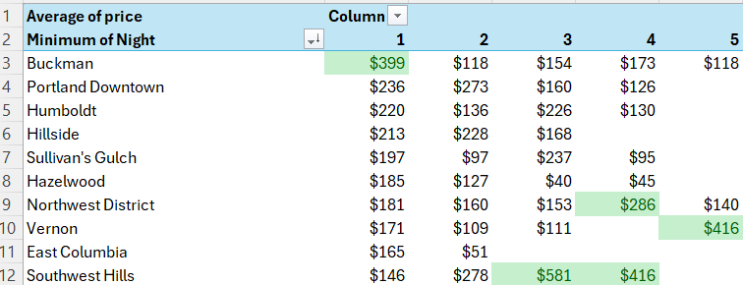
Question 4
By considering all of these factors, how can we accurately rank neighborhoods in Portland and identify the top 5 locations for short-term rental investment?

Slide 13
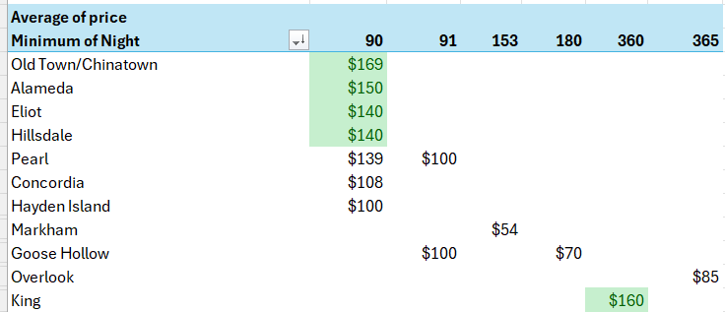
Question 4
By considering all of these factors, how can we accurately rank neighborhoods in Portland and identify the top 5 locations for long-term rental investment?

Slide 14
Conclusions
Leverage both controllable & uncontrollable risk factors.
Prioritize high demand neighborhoods.
Boise, Concordia, Buckman, King, and Richmond are hot spots for review activity.
Investing in Entire Homes or Apartments is the most popular strategy.
Sunnyside, Richmond and Creston Kenilworth offering opportunities in private rooms.
Buckman, Northwest District, Vernon, and Southwest Hills are the top 5 neighborhoods in Portland for short-term rental investment (1-5 days).
Old Town, Alameda, Eliot, Hillsdale, and King are the top 5 neighborhoods in Portland for long-term rental investment (90-365 days).

Slide 15

- END -

Slide 16
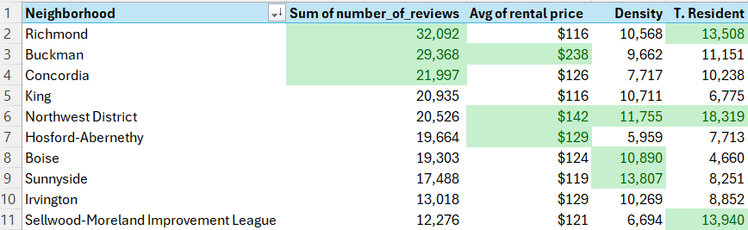
Supplementary Data
How does population density correlate with rental demand, and can we assume that higher housing densities indicate higher demand, thus leading to higher rental prices?
How does the total residential population of a neighborhood correlate with rental demand and market stability?

Slide 17
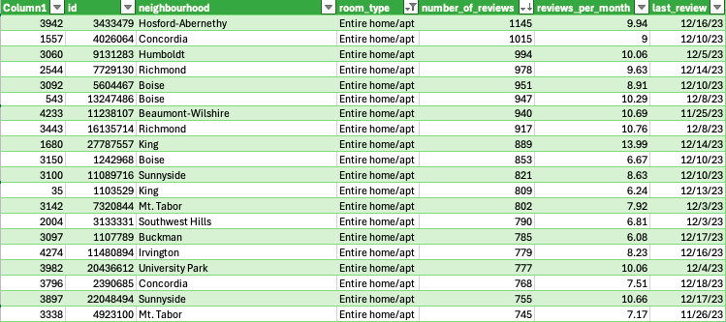
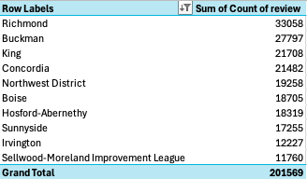
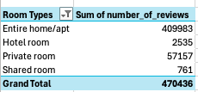
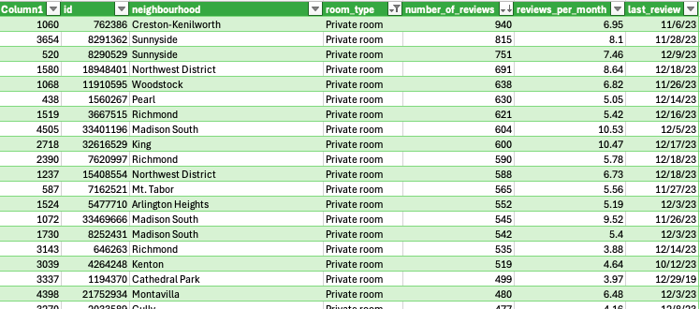
Notes:
Anchal We counted the number of tasks using the date columns in Airbnb reviews file and link that data to the Airbnb listings file to create a consolidated data set.
By referencing the neighborhood column and review count, we identified the top 10 most reviewed or popular areas in Portland. Rooms.We filtered the data further to separate demand areas for entire room rentals and private
we then used the room types column along with the number of reviews per room type to determine the most popular listings by room category.

Slide 18
Real Estate Implications and Investment Insights:
Entire Homes/Apt generate the highest number of reviews making them the most profitable investment option for short term rentals.
Private rooms in high demand neighborhoods ( Sunnyside and Richmond) offer an alternative revenue stream especially for investors who want to cater to budget conscious travelers.
Boise Richmond and Sunnyside stand out as a strong investment area due to their high-ranking in both entire home and private room rental categories.
Hotel and shared room listings receive minimal engagement, suggesting they may not be the best investment choice in Portland Market.
By leveraging these insights, a real estate company can identify high demand neighborhoods optimize price strategies and maximize revenue potential in Portland short term rental market.
Notes:
Entire Homes/Apt generate the highest number of reviews making them the most profitable investment option for short term rentals.
Private rooms in high demand neighborhoods ( Sunnyside and Richmond) offer an alternative revenue stream especially for investors who want to cater to budget conscious travelers.
Boise Richmond and Sunnyside stand out as a strong investment area due to their high-ranking in both entire home and private room rental categories.
Hotel and shared room listings receive minimal engagement, suggesting they may not be the best investment choice in Portland Market.
By leveraging these insights, a real estate company can identify high demand neighborhoods optimize price strategies and maximize revenue potential in Portland short term rental market.

Slide 19
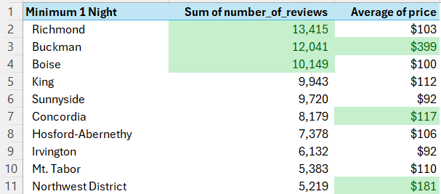
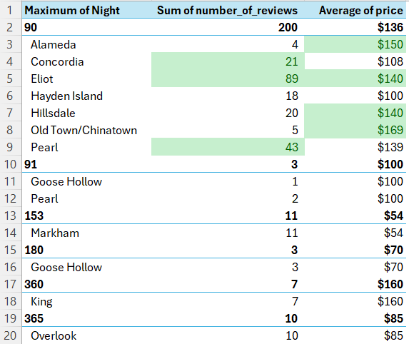
Supplementary Data
How can the minimum or maximum number of nights a property is booked indicate the level of demand in a specific neighborhood, and how does this impact rental pricing and property investment strategies?

Slide 20
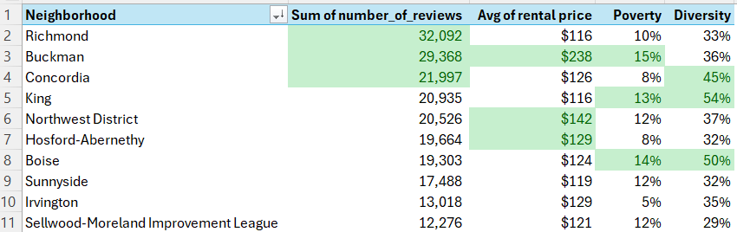
Supplementary Data
How does the poverty percentage in an area impact the rental market and the types of renters attracted to specific neighborhoods?
How does neighborhood diversity (percentage of diverse populations) affect rental demand, and what patterns can we observe?

Slide 21
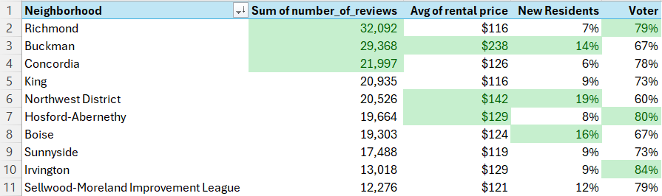
Supplementary Data
How do the percentage of new residents and voter participation rates in a neighborhood provide insights into the rental market and overall desirability?

Slide 22
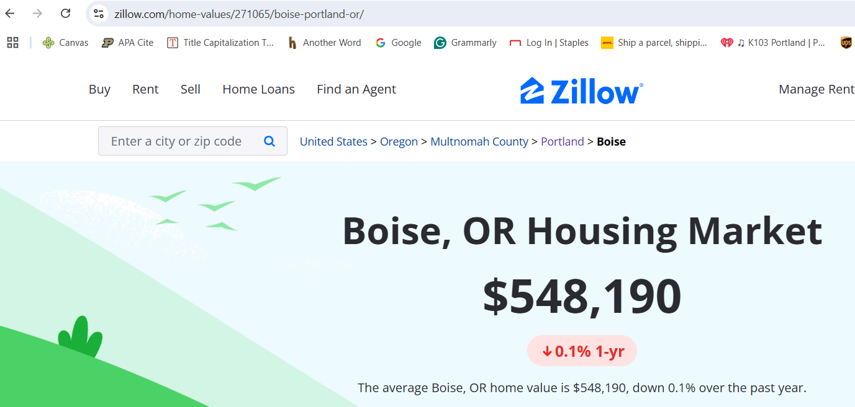
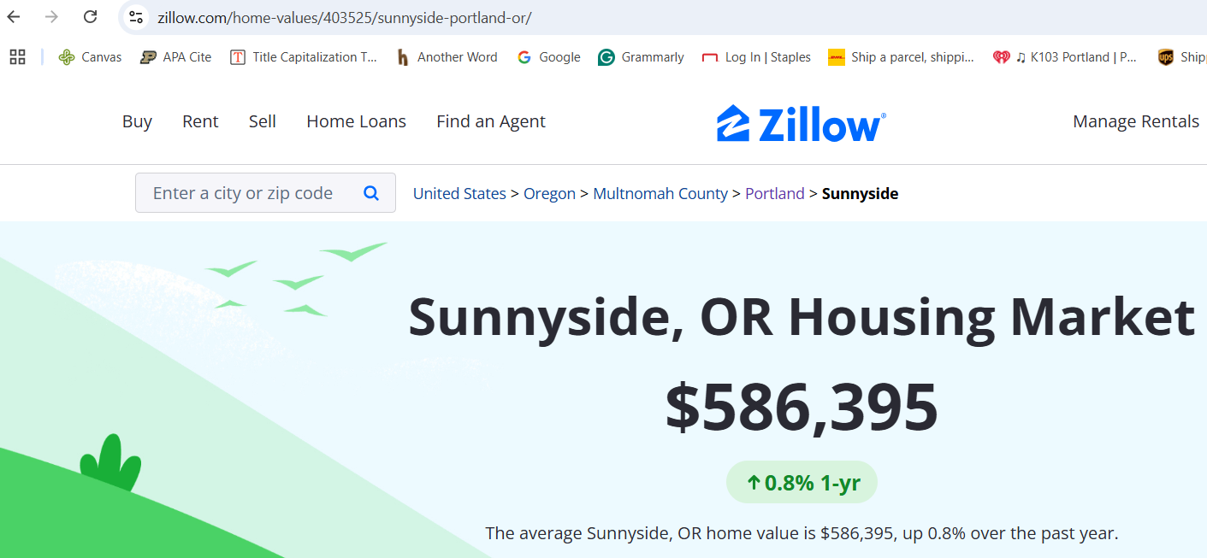
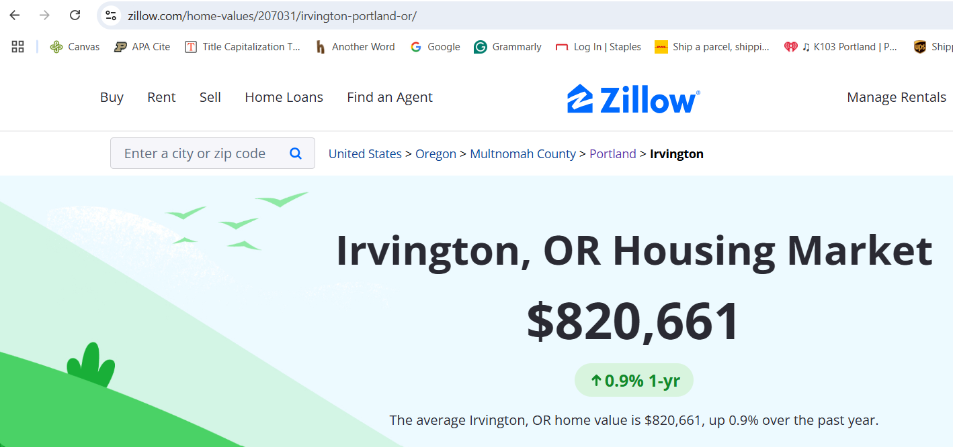
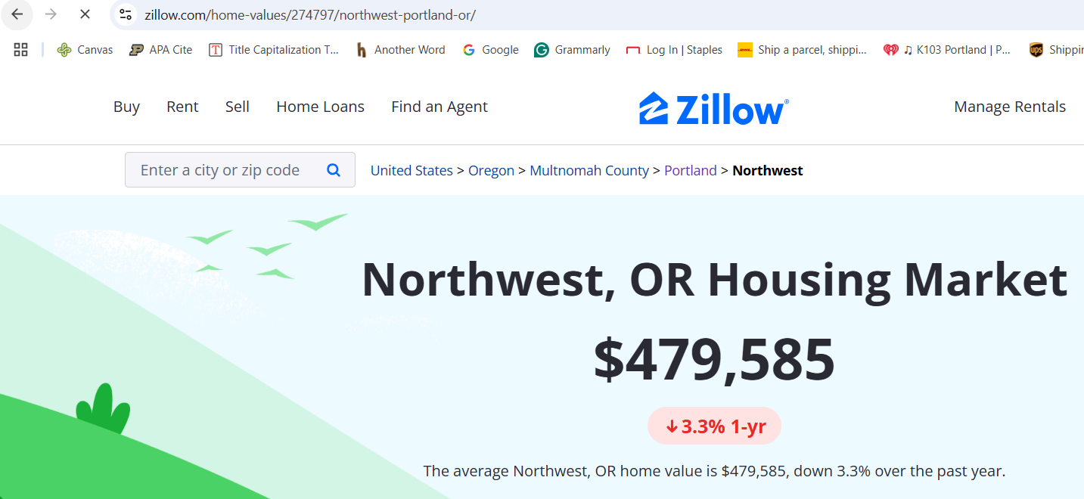
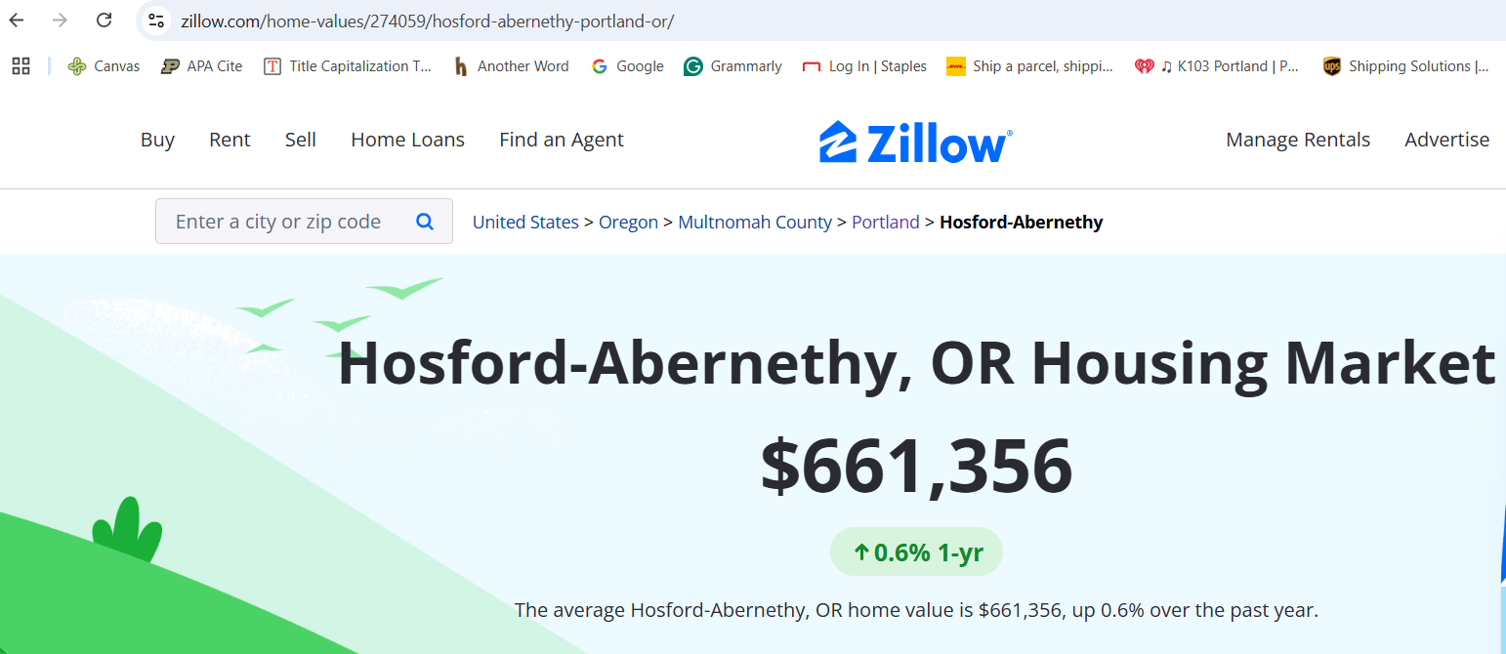
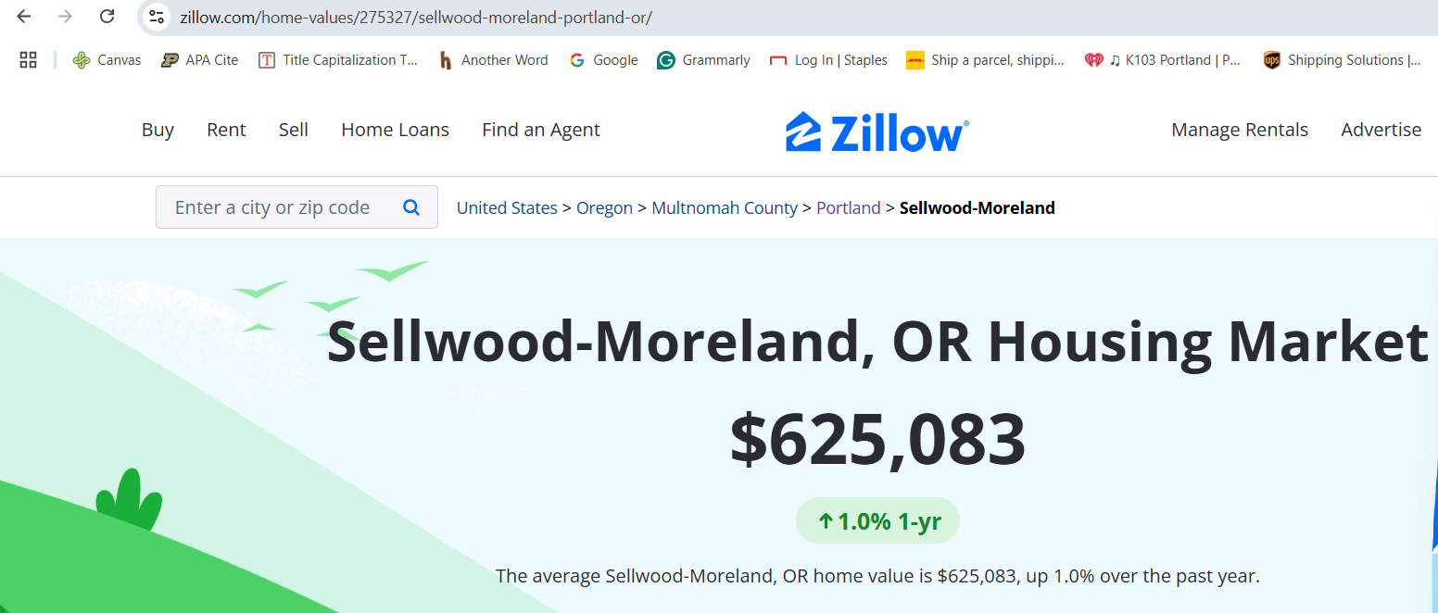
Reference: Secondary Data
Average Home Value
https://www.zillow.com/home-values/276532/richmond-portland-or/
https://www.zillow.com/home-values/271068/buckman-portland-or/
https://www.zillow.com/home-values/207031/irvington-portland-or/
https://www.zillow.com/home-values/275327/sellwood-moreland-portland-or/
https://www.zillow.com/home-values/271065/boise-portland-or/
https://www.zillow.com/home-values/403525/sunnyside-portland-or/

Slide 23
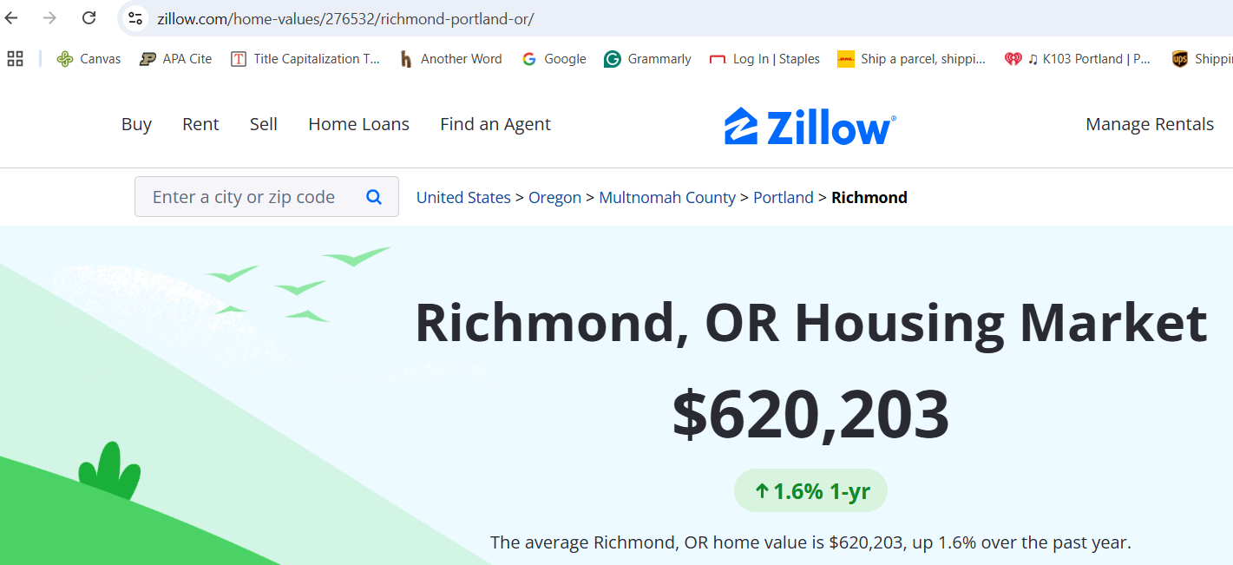
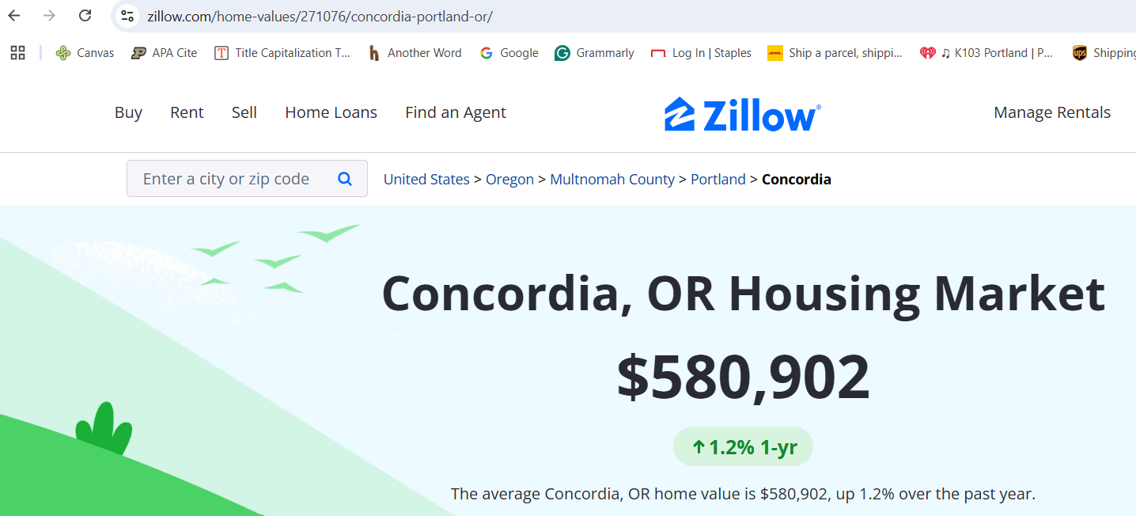
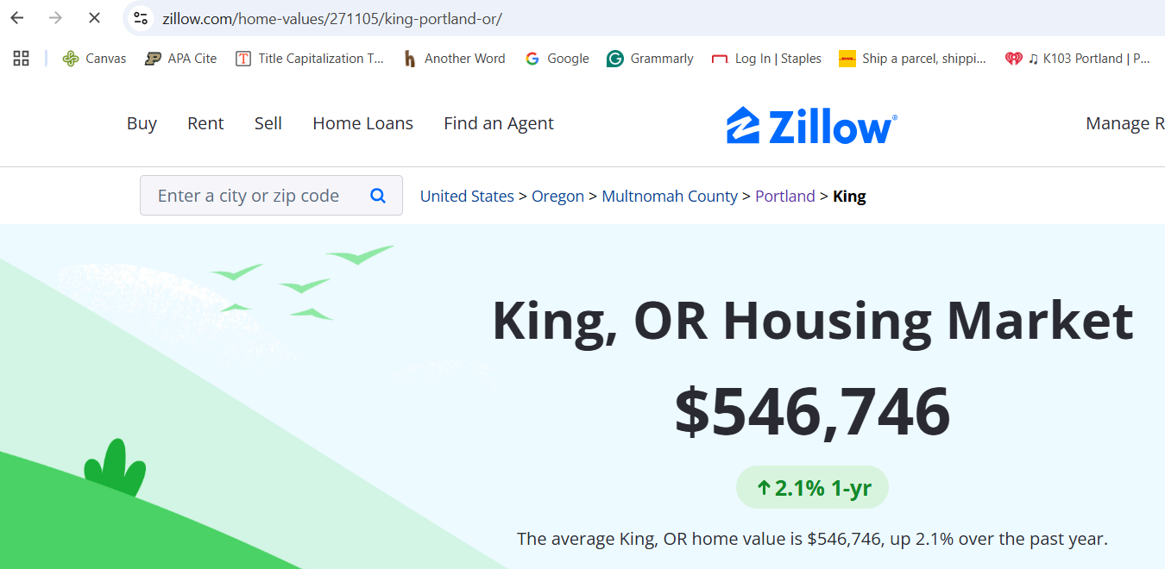
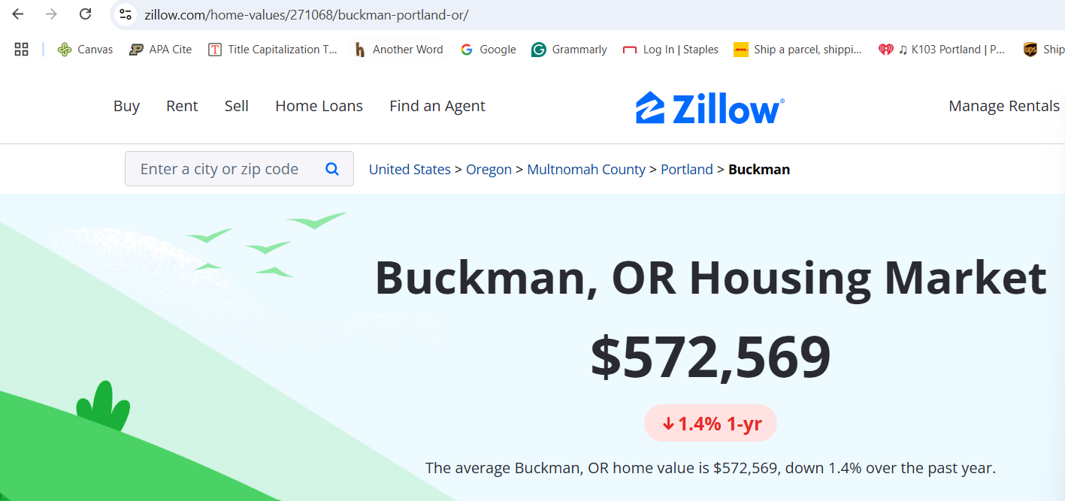
Reference: Secondary Data
Average Home Value
https://www.zillow.com/home-values/274797/northwest-portland-or/
https://www.zillow.com/home-values/274059/hosford-abernethy-portland-or/
https://www.zillow.com/home-values/271105/king-portland-or/
https://www.zillow.com/home-values/271076/concordia-portland-or/

